Slide 1
Grades at School

Slide 2
What are grades for?
* a snapshot of where the students are at
* information for parents and students

Slide 3
How are grades determined?
Teachers do a variety of things to assess students at each grade level
* class work
* quizzes
* tests
* assessments (reading, writing, math)
* interviews with the student
* project work

Slide 4
Assessment
In education we assess for two main reasons:
* FOR learning
* OF learning

Slide 5
What is Assessment FOR learning?
* gives the student ongoing feedback about how they are doing
* gives the student information about how they can improve

Slide 6
What is Assessment OF learning?
* final assessment of learning on a particular unit or skill
* shows what the student knows and doesn’t yet know

Slide 7
How does Assessment occur?
Teachers use all kinds of tools to do assessment:
* Assessment tools (AB diagnostic, Jerry Johns)
* class work
* quizzes
* tests
*student-teacher interviews
* project
* teacher observations

Slide 8
How does Assessment link up with Grades?
Hamburger Rubric
If the teacher has asked the students to give her a hamburger and they give her a…

Slide 9
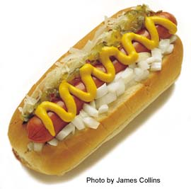
Hamburger Rubric
Hot dog…. That was not what was asked for and therefore is not meeting the expectations for work and would achieve a 1

Slide 10
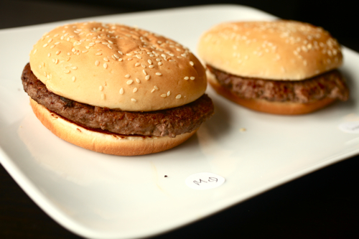
Hamburger Rubric
Hamburger with no condiments
This would be achieving the criteria in the most minimal of ways and would achieve a 2

Slide 11
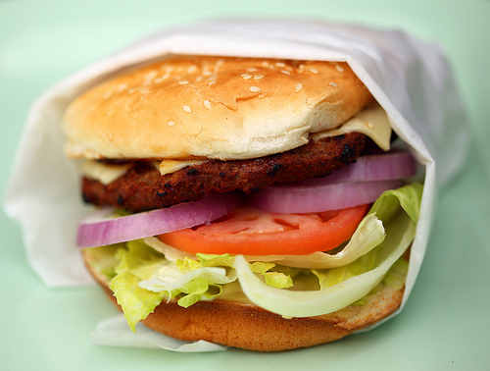
Hamburger Rubric
Hamburger with all possible condiments
This is fully what was asked for and would achieve a 3

Slide 12
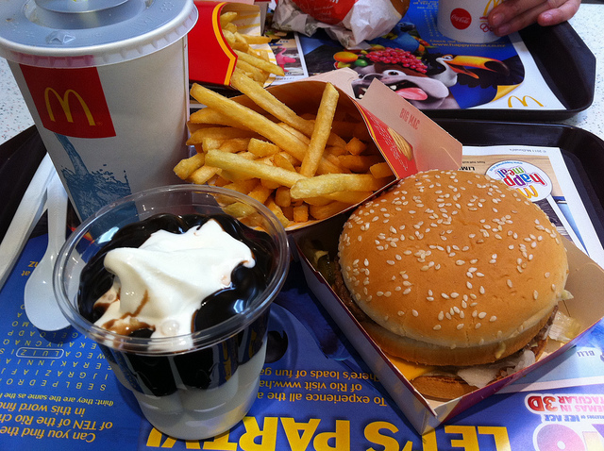
Hamburger Rubric
Hamburger with fries, a drink and dessert
This is MORE than what was asked for and therefore achieves a 4

Slide 13
Grades
4 = A Exceeding Expectations
3 = B/C+ Meeting Expectations
2 = C Minimally Meeting Expectations
1 = C- Not Yet Meeting Expectations

Slide 14
Rubric for Marking
* Teachers also use rubrics for marking of major assignments and projects
* Can be teacher-created or class—created
* Follows the same 1-2-3-4 criteria

Slide 15
Curriculum Criteria
www.bced.gov.bc.ca/irp/curric_grade_packages/gr6curric_req.pdf
http://www.bced.gov.bc.ca/perf_stands/writing_g6.pdf

